Slide 1
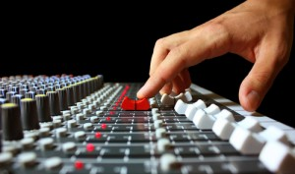
Audio Workshop

Slide 2
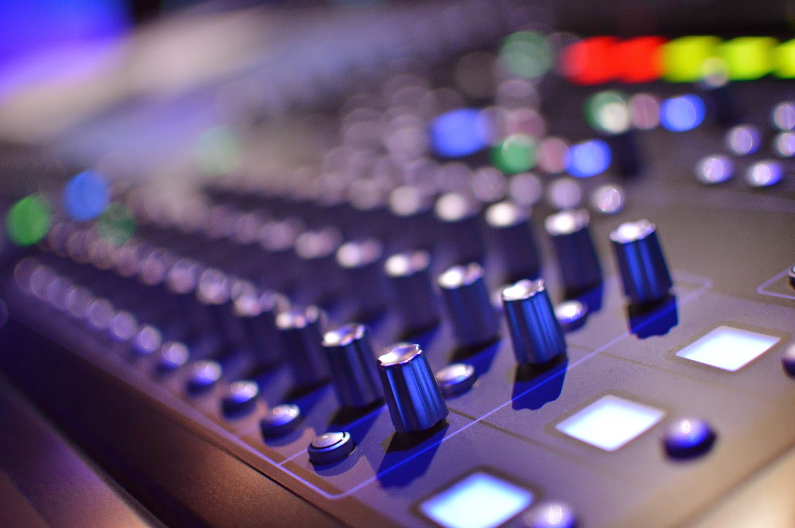
What will we discuss?
* Why are you an Audio Engineer?
* Typical tools of the Trade
* How Sound Works
* Volume – What is it
* Microphone Types and their use
* Gain – Why it’s the most important thing to know.
* The channel strip explained. Simplest to the Most Complex
* Monitoring - In your Ear or on the Floor
* Mixing Techniques

Slide 3
Why am I here?
I am Paid Staff
Very few technical persons fall under this category.
You may be paid to engineer a wedding or funeral.
I am a volunteer
Almost all of the FOH (Front of House) audio persons are volunteers.
You dedicate a sum of hours per week to provide this service for your local Church. You are the only person in your Church with this capability.
You are on call to help or you are a member of a several person team. You may work in the audio booth a couple of times a month.

Slide 4
So most of us Volunteer.
How did you get to be the “Audio guy” (or Gal) for your Church!
You have a passion for the Art of Audio
You were asked to join the Team because of history as an audio tecky.
Ole Joe didn’t show up so I jumped in to help.
No one else will do it…..
If you fall in the last two categories, you are not alone. I would say that the majority of audio persons have little or no experience when they first sit behind a mixing console.
This is a very intimidating position that you’ve put yourself into.
You want to do a great job but time doesn’t allow you to learn the correct way to accomplish “great”. So what happens next……

Slide 5
Ahhhhhhh!!!
Audio in the Church is a huge part of the worship environment.
Problems occur that you must have the knowledge to correct and usually it’s a quick decision.
Music Ministers (or Pastors) throw in an “element” that you have not rehearsed nor had the time to test or plan for.
You are frustrated because you volunteered for a position that you are not capable of doing and now your trapped.
Lastly – You do a great job and no one notices.

Slide 6
It has been said over and over that the best audio engineer is never recognized simply because if the mix is great no one notices.
But, let one spike of feedback run through the system or the pastors microphone stop working and everyone will turn around and look at YOU. It’s YOUR fault, it’s YOUR responsibility.
Wait a minute…. I’m a Volunteer, I don’t have to do this…..
This should never be the case. DON’T QUIT.
Lets fix this……

Slide 7
Did transition cause all of this?
It is my opinion that the transition to contemporary styling has caused the Church to play catch-up on most of the technical arts.
Traditional church styling didn’t present the problems we face today.
You may have had one handheld mic, a podium mic and possibly two overhead choir mics, an 8 channel mixer and Miss Mary on Piano. That was it…
Now we have two to three dozen channels of mics, instruments, computer audio, audio from CD players, etc. AND an artist ego to go with each input. (That was suppose to be funny)
Our systems are still a center cluster designed for voice only and we are pouring everything bit of audio we have into a speaker never designed to take this abuse.
…….but, is that a bad thing?

Slide 8
I personally went through the transition process as a bass player in a contemporary praise band. For years we struggled for equipment, talent and mostly support from the church.
While the leadership of our church supported the transition, a large portion of the congregation did not.
We were able to successfully move into a contemporary style by simply doing one thing.
We all stood together. The elders, deacons, pastors, worship leaders. EVERYONE. Supporting each other all of the way.
So how does this apply to little ole you……

Slide 9
The leadership of your church must support what you are trying to do. Everything from how much to how loud should be collectively discussed and agreed upon. This is imperative to a long, trusting relationship with your congregation.
The leadership should understand your role.
As a audio engineer you will be tasked with things you never dreamed of. It is highly important that the leadership of your church train you to accomplish these task and support you when you fail.
Your worship leader should respect your role and give you the resources and time you need to do your very best.
You need to develop unique relationships with instrumentalist, vocalist, youth ministers or whomever you may come in contact with as a part of your role as audio engineer. It is critical that you are trusted and respected by everyone of them.

Slide 10
TRUST
Leadership:
I trust you to do your best and strive for excellence.
I trust that you will do your job within the guidelines we agree upon.
I trust that you will train yourself and practice your trade.
Audio Engineer:
I trust that you will support my role.
I trust that you will train me and allow me to strive for excellence.
I trust that you will welcome feedback when I see a needed change.

Slide 11
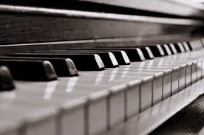
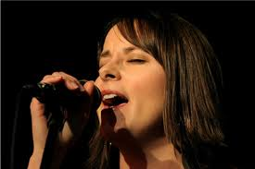
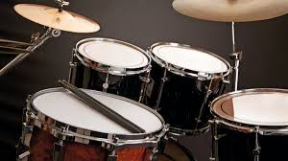
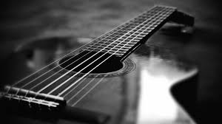
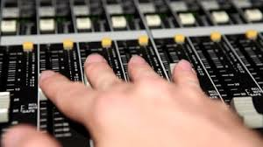
How do you see your role?
Pianist
Vocalist
Drummer
Guitarist
Audio Engineer?
What is the difference?
Your console is your instrument….
break

Slide 12
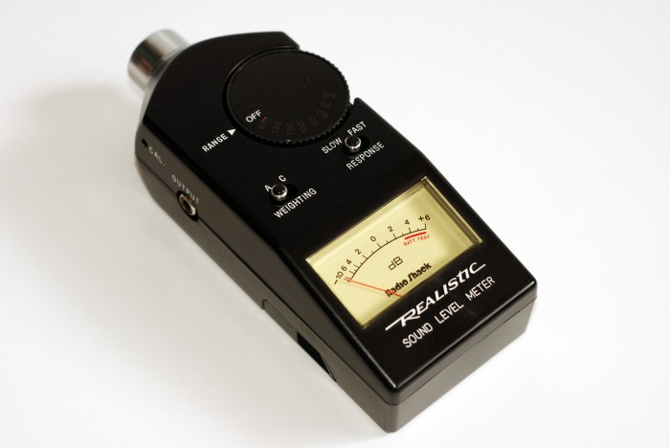
Tools of the Trade
Sound Level Meter
Inexpensive, $30-$90
Consistent Volume in Room
Great Training Tool
Several Apps in the Apple Store

Slide 13
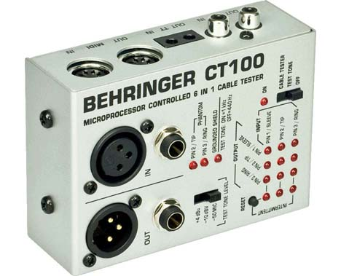
Cable Checker
Quick troubleshooting
Most models will send tone to check signal path
Can check multiple connector types
$40-$80

Slide 14
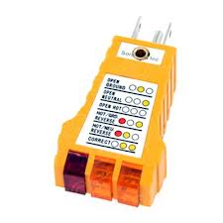
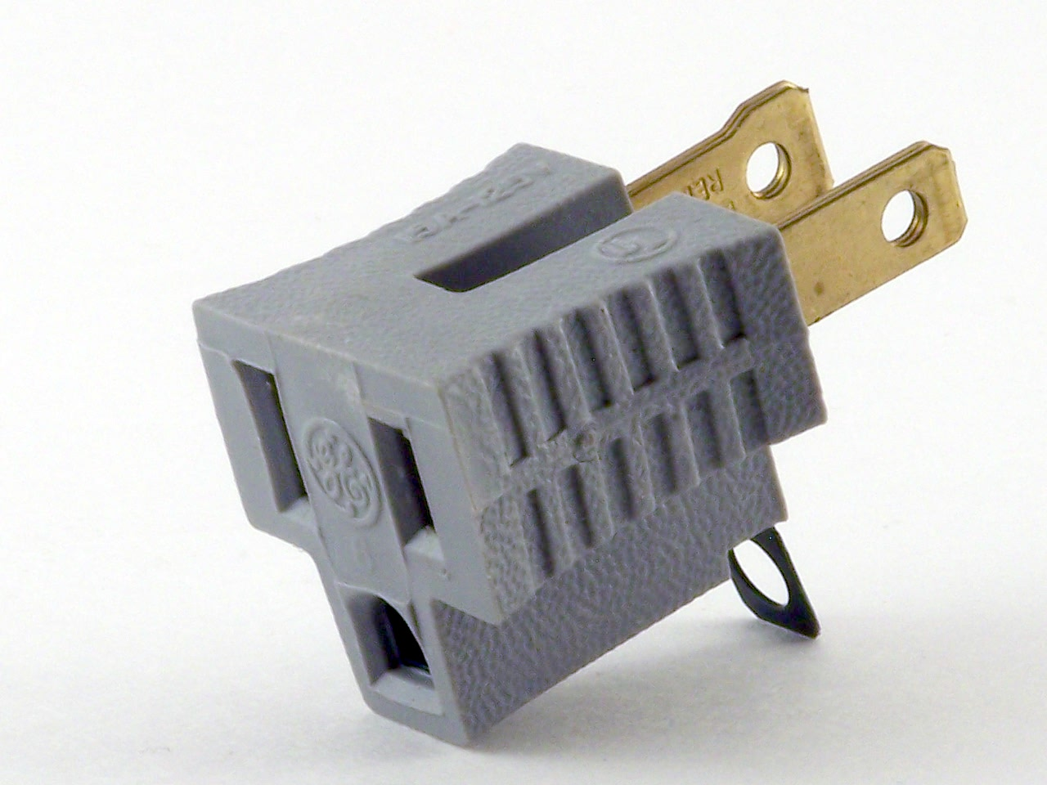
Electrical Ground Checker
Used to check for correct wiring.
Reduces possible ground loops.
NO!

Slide 15
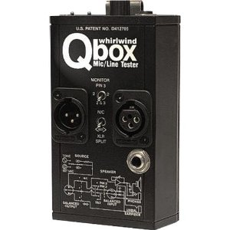
Q-Box
Great troubleshooting tools.
Tone generator
Check signals with internal amplified speaker
$159

Slide 16
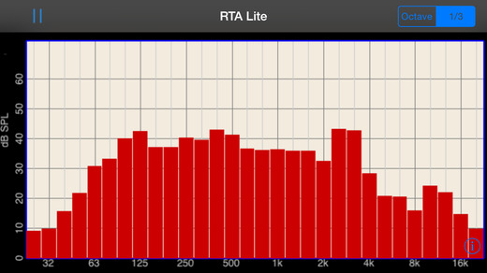
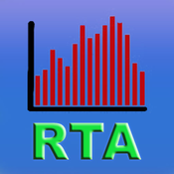
Suggested App
RTA Lite – free from the apple store
Use to find trouble frequencies / feedback
Training aid

Slide 17
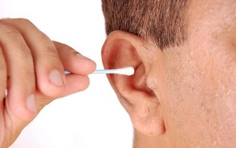
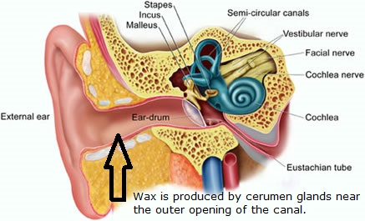
Q-Tip and Peroxide
Clean ears are your best friend
This is greatly overlooked
The ear is a diaphragm
Would you allow a glob of peanut butter to be on your microphone?

Slide 18
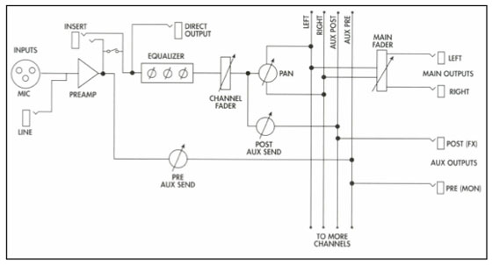
Now for the Technical Stuff!!
Signal Path
Source
Preamp
Insert
Direct Out
Aux Sends
Equalizer
Channel Fader
Main Fader
Metering

Slide 19
Source
The source is anything generating signal to your mixer.
Vocal Mic
Guitar Amp
Keyboard
Instrument Direct Box
CD Player
Computer

Slide 20
Gain / Discreet Preamp
Some common levels you'll see:
+4 dBu is "professional" line level, common in modern pro recording gear.
0 dBv is an average line level, typical output from rackmount guitar/bass preamps.
-10 dBv is "consumer" line level, common with older gear.
-20 dBu is roughly in the neighborhood of a typical instrument's output.
-30 dBu is again in the neighborhood of a typical microphone or DI box's output
Hint: Use the “Solo” or “PFL” button to monitor input gain

Slide 21
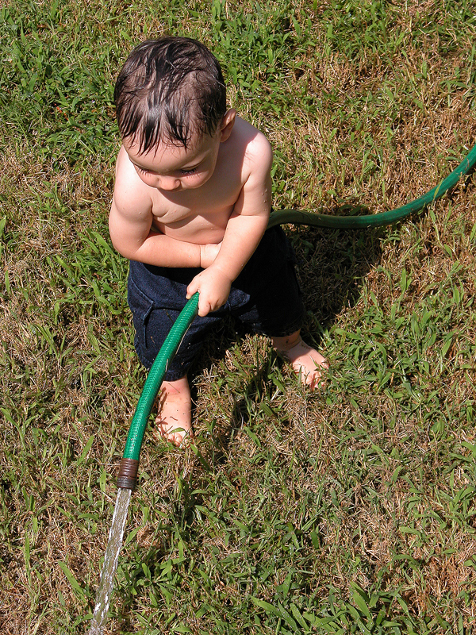
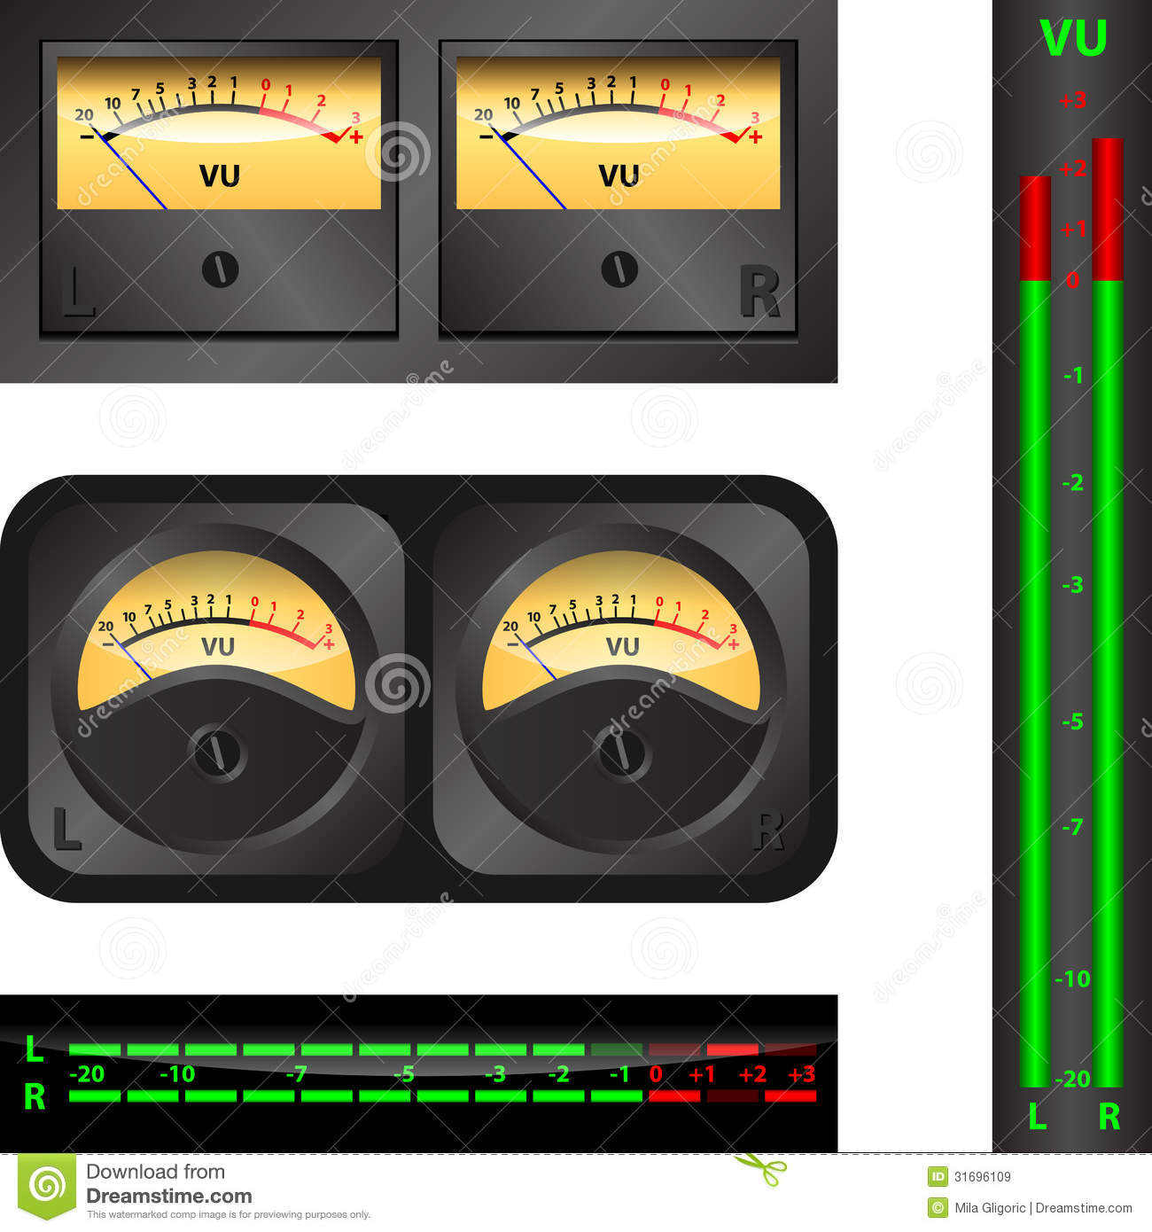
Signal is controlled by the Gain (preamp) potentiometer (knob) on most consoles.
To monitor the amount of signal coming into a channel use the meters on the console. To view the input gain on any channel you can press the solo or PFL button. You will then see the channel input gain on the main meter. Set the peak gain to 1 to 2 db above unity or 0.
Signal in control
Signal out of Control
Noise – Unwanted sound in your system due to bleed from other instruments or excessive gain on a channel.

Slide 23
Distortion (Clipping)
Distortion occurs when signal overloads any given gain stage.
As peaks exceed the capacity of a gain stage, the tops of the waveforms are clipped off, leading to distortion in the signal.
Unexpected peaks are the primary cause of clipping in the preamp, but distortion is also common in intermediary gain stages, such as the EQ or dynamics processing.
The only way to avoid distortion is to prevent the signal from overloading gain stages.
Most consoles provide a Pad button. This applies a -20db reduction in gain to accept signals hotter than the console can accept before clipping. Using the Pad or -20 feature should be your last resort for achieving optimum gain. Reduce your source signal if possible.

Slide 24
Signal to Noise Ratio Headroom Unity Gain
The signal-to-noise ratio (S/N) is the proportional amount of dB between the nominal operation level and the noise floor. The higher the S/N, the lower and less noticeable the noise is.
Headroom is the difference between the nominal operating level and clipping. While less headroom means greater overall signal loudness, more headroom means sudden peaks are less likely to cause distortion. Proper gain staging provides the perfect balance between loudness and headroom.
Often indicated by a U, unity gain is when a gain stage in a piece of equipment (e.g., a channel fader on a mixer or an output volume knob on a compressor) neither boosts nor cuts the incoming signal. In other words, by achieving unity gain, you affect the signal as little as possible

Slide 25
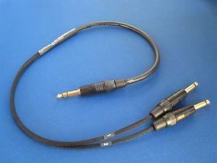
Insert

Slide 26
Direct out
The direct out output on some consoles is designed to send signal from individual channels to another recording or processing device.
This signal can either be post or pre (I’ll explain that later) and if pre is usually only affected by the gain on a channel.
Extremely useful for recording from the console to a CD player or multi track recorded.

Slide 27
Aux sends
Commonly know as a “monitor send”
Used to send signal to stage monitors, effects, recording.
Pre fader Aux Send
Used mainly for stage monitors. This pre fader send is not effected by the channel fader so changes in house volume do not effect the stage monitoring. Most consoles “mute” or “off” button will disable the pre fade aux send.
Post fader Aux Send
Used for effects or other sends where the signal is effected by the channel fader. This is useful for a reverb, delay or recording aux send.
Most consoles capture the signal for a pre fade aux after the eq and gain.

Slide 28
Equalizer
The Equalizer or “EQ” is designed to cut or boost selected frequency.
EQ cannot boost frequencies not available in the source signal.
EQ will boost gain.
Four typical types of EQ
Shelving EQ Low and High
Parametric EQ
Sweepable EQ
Graphic EQ
So what are frequencies?

Slide 29
Frequencies
audible frequency is characterized as a periodic vibration whose frequency is audible to the average human. The unit of audio frequency is the hertz (Hz). It is the property of sound that most determines pitch.
The generally accepted standard range of audible frequencies is 20 to 20,000 Hz, although the range of frequencies individuals hear is greatly influenced by environmental factors. Frequencies below 20 Hz are generally felt rather than heard, assuming the amplitude of the vibration is great enough. Frequencies above 20,000 Hz can sometimes be sensed by young people. High frequencies are the first to be affected by hearing loss due to age and/or prolonged exposure to very loud noises.

Slide 30
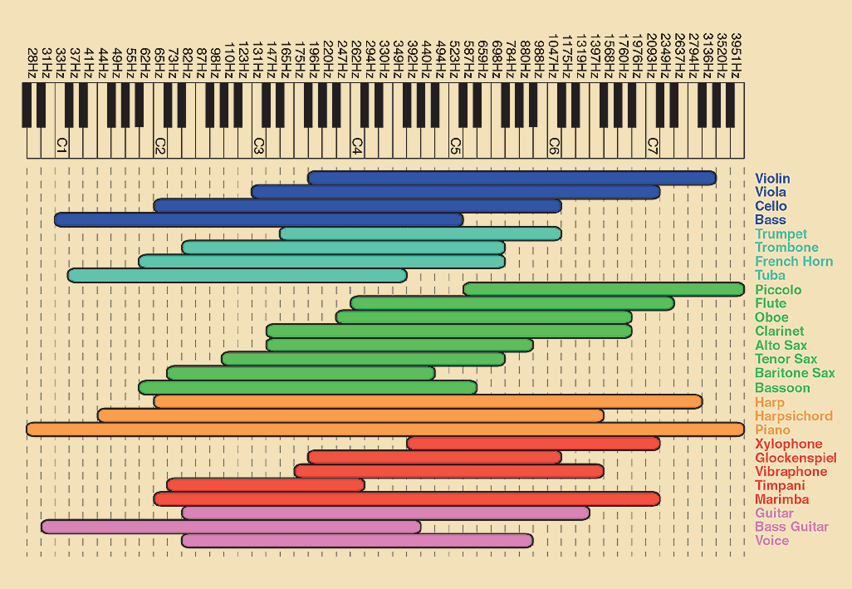

Slide 31
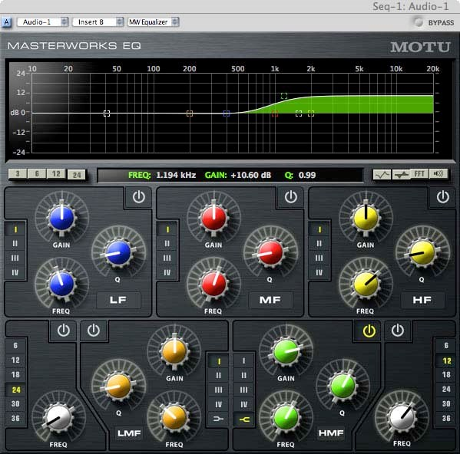
High Shelf EQ
Most typical type of High EQ on standard consoles.
Frequencies are boosted or cut above a preset frequency.
Most consoles have a set high shelf at 12K at +/- 15 db

Slide 32
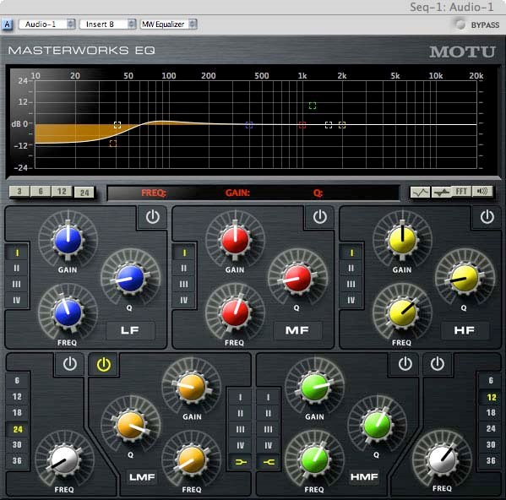
Low Shelf EQ
Most typical type of Low EQ on standard consoles.
Frequencies are boosted or cut below a preset frequency.
Most consoles have a set low shelf at 80hz at +/- 15 db

Slide 33
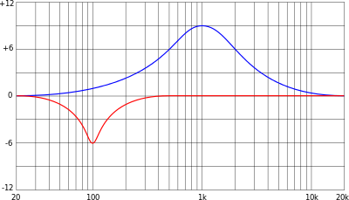
Sweepable EQ
Usually adjusted with two control Knobs.
One selects the frequency
The other selects boost or cut.

Slide 34
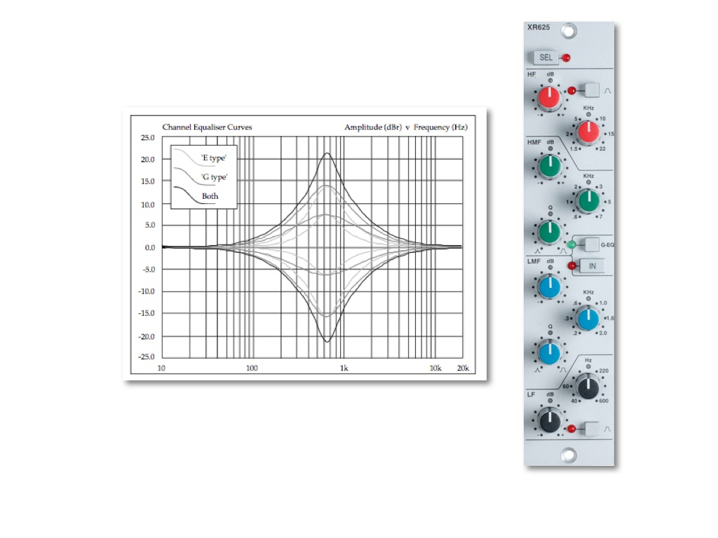
Parametric EQ
Advanced type of EQ
Controlled with three control knobs
Frequency
Boost or Cut
Q or bandwidth
Notch filtering

Slide 35
Graphic EQ
Usually installed between the console and power amps
Each frequency is a sweepable EQ type with a narrow Q or bandwidth.
Most graphic EQ’s have an output gain or “make up gain”. Be careful here!!

Slide 36
Low and High Pass Filtering
Most consoles label these filters as LPF or HPF
A high pass filter cuts frequencies at 18-20db per octave at a specific frequency. Usually 75-100 hz
Most consoles will have High Pass Filters (Low Cut)
Advanced consoles feature Low Pass Filters
The High Pass filter only allows the higher frequencies to pass
The Low Pass filter only allows the Low frequencies to pass.

Slide 37
Channel Fader
Used to cut or boost volume (signal) to the Master Fader
Used to combine or blend different channels of audio into a final mix.

Slide 38
Master Section
Final step before your Mix goes to the Speakers
Group sub mixes are blended here.
Auxiliary Master section lives here.
Metering is done in this section

Slide 39
Master Fader Section
The Master Signal gain should be higher or “hotter” than any signal upstream.
Group sub mixer

Slide 40
Auxiliary Master Section
Master volume for stage monitors
Master gain for signal sent to recording or effects

Slide 41
Metering
Vital information shows up here in the form of little lights (hopefully not red ones)
Used for Pre Fade Listen (PFL) of Individual Channels
Used for After Fade Listen (AFL) of groups or Master outputs.
Monitors Master output going to amps and speakers.

Slide 42
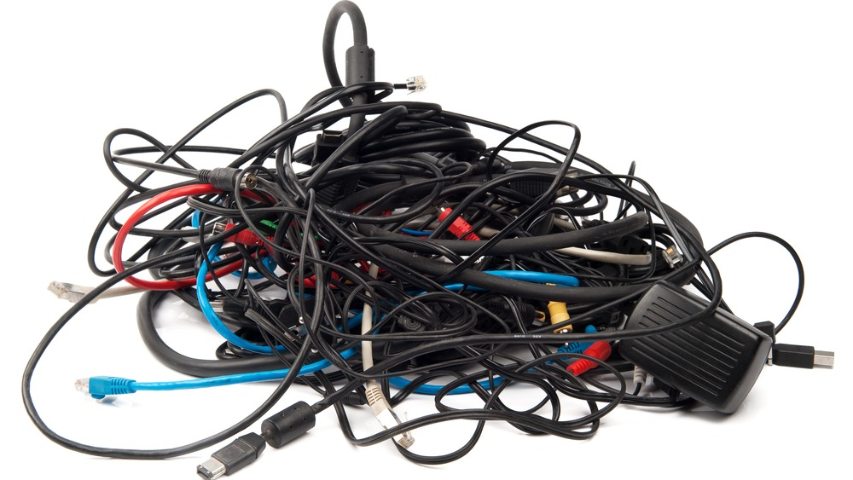
Cables
In this section we will learn about the different cable types and their roles and importance.

Slide 43
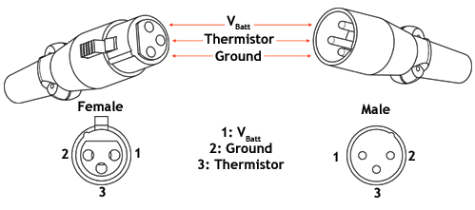
XLR Cables – Typical Microphone cable.
Balanced XLR cables will have an XLR type connector on each end.
Some balanced cables may have an XLR connector on one end and a TRS (Tip, Ring and Sleeve) connector on the other.
An unbalanced XLR cables will have an XLR connector and a TS (Tip Sleeve) connector. This is the least desirable type of microphone cable.
Balanced XLR-XLR
Balanced XLR-TRS
Unbalanced XLR-TS

Slide 44
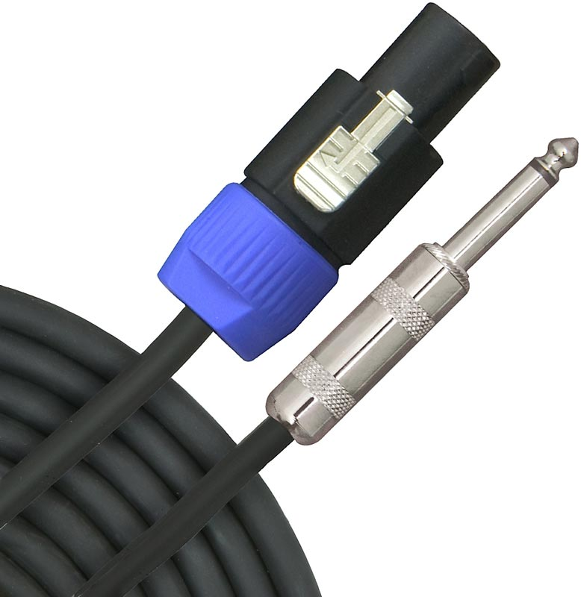
Speaker Cable
Speaker cables need to be larger in wire gauge than instrument or microphone cables.
Speaker cables carry more voltage than instrument or mic cables. This higher current demands a larger diameter to prevent signal loss over longer runs.
Using an instrument cable in place of a speaker cable can result in melting of the wire and/or loss of performance.

Slide 45
Instrument Cables
Typical use is for guitar, bass and keyboard.
Shielded to prevent RF or interference from other sources near by.
Quality is paramount here. Like Mic cables, you get what you pay for.
Do not use instrument cables for speaker cables.

Slide 46
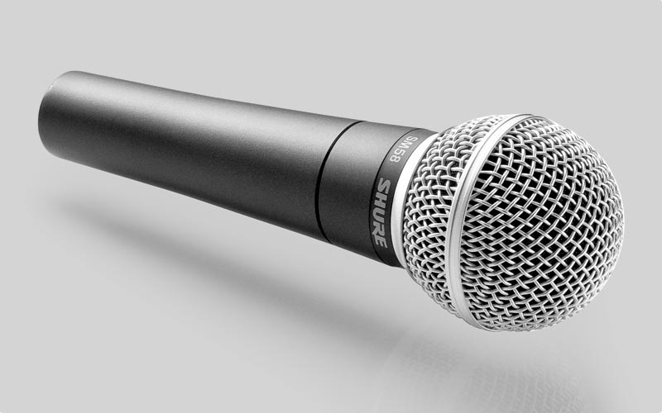
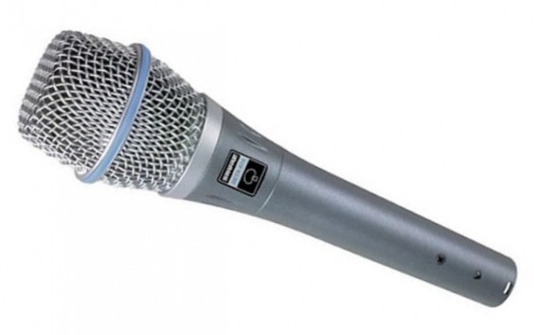
Microphone types
Dynamic
Shure SM-57
Shure SM-58
EV NAD 267, 367, 767, etc.
Sennheiser e835, e945, etc.
Condenser
Shure SM-87a
EV RE410
Sennheiser e965

Slide 47
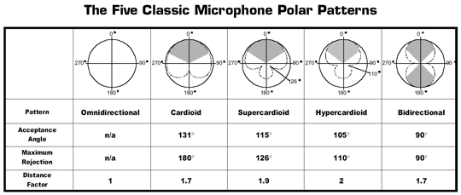
Microphone Patterns
Omni directional
Cardioid
Super Cardioid
Hypercardioid
Bidirectional
Phantom Power
Most condenser mics require some type of power. Some come with batteries but most get their power from your console. The “+48vlt phantom” button will supply the channel with mic power. Some consoles allow individual channel 48v phantom but most allow you to send phantom in banks of 8 channels.

Slide 48
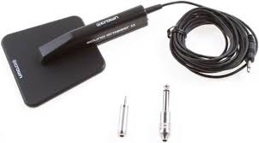
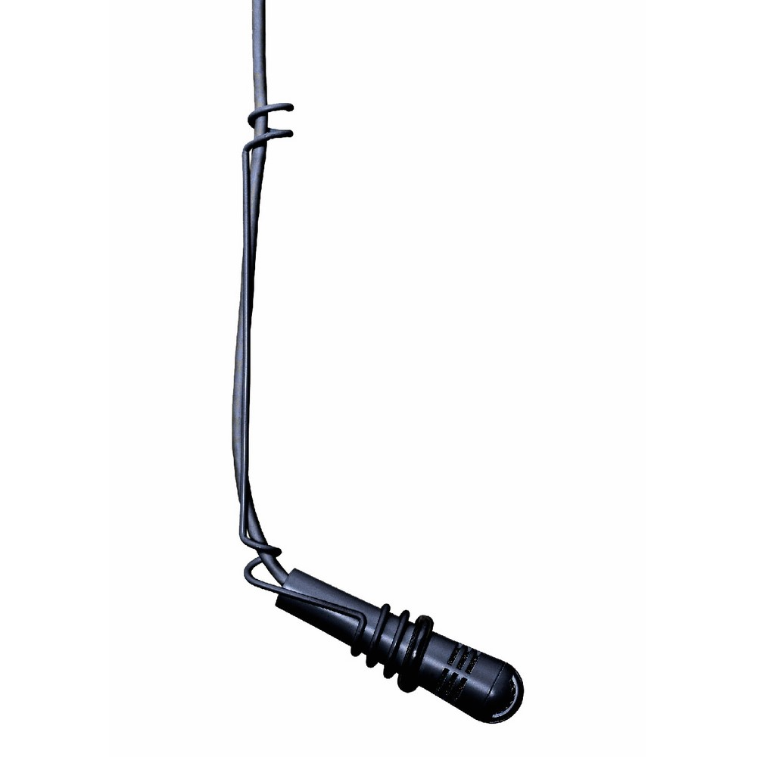
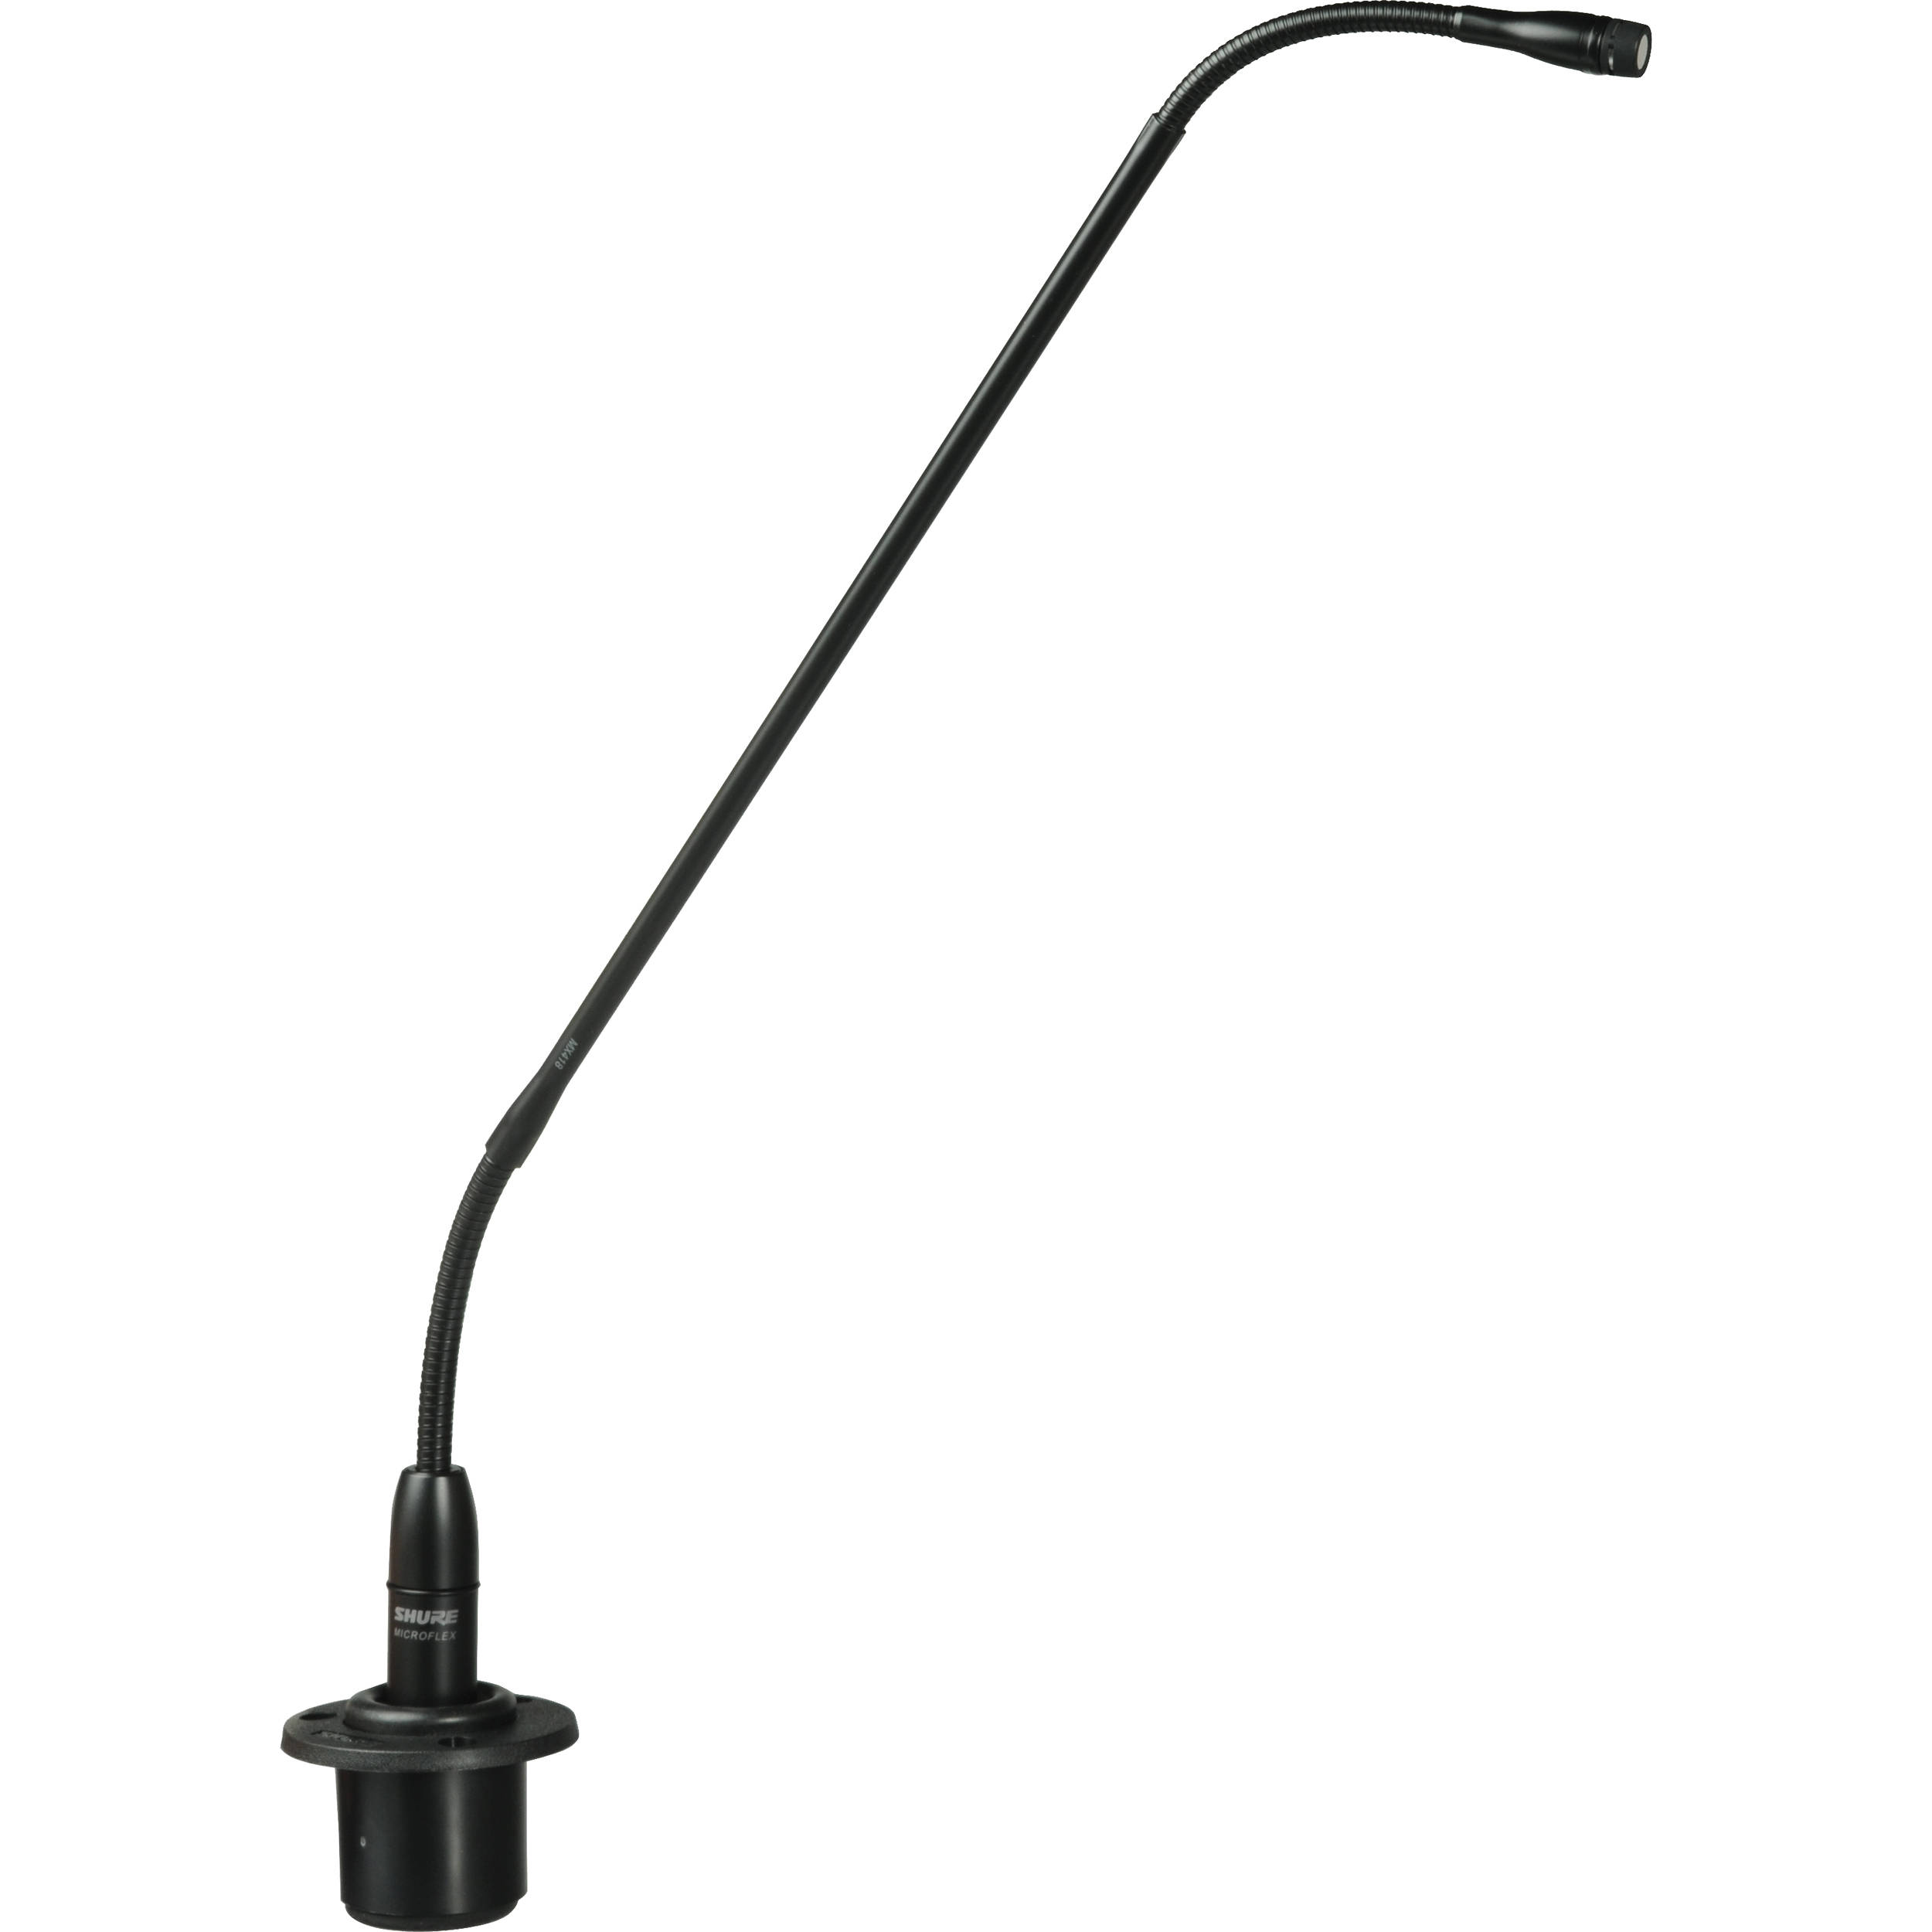
Other Microphones
Floor or table mics (condenser)
Overhead Choir mics (condenser)
Podium mics (condenser)

Slide 49
Wireless Mics
Three levels of gain on most mics
Gain in the handheld or beltpack (source from the microphone)
Gain or volume of the receiver (signal to the console)
Gain at the console (signal from the microphone)

Slide 50
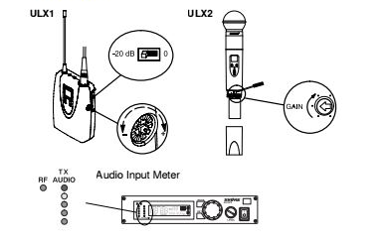
To achieve optimum source gain you can attenuate the handheld or beltpack so that the source volume is not clipping the receiver.
Once the source gain is achieved you will need to verify that the volume leaving the receiver is not overdriving your console.

Slide 51
Conclusion
Helpful links
https://soundaudition.com
Audio exam. Very helpful in determining the talent level of your audio engineers.
https://www.facebook.com/groups/ChurchSoundMediaTechs/?fref=nf
Group dedicated solely to Church Technical Arts
Contact me: Kimble Slaton, Owner of Hummingbird Recording Studio in Vicksburg, Ms.30 plus years in audio engineering. Currently serving as FOH engineer, Crossway Church, Vicksburg, Ms.
slatonki@gmail.com 601-831-7252 cell

